Slide 1
TWIDDLER
Rui Li, Yufan Xue
Software Engineering
April 4, 2014

Slide 2
OVERVIEW
Manage assessment activities for academic programs
  Student learning outcomes(organized around hierarchically categorized)
Support multiple Universities
Support other types of academically oriented clients

Slide 3
STUDENT LEARNING OUTCOME
short statement that describes a specific objective for some academic unit
SLO's are associated with courses, programs, degrees and perhaps others. These mappings form possibly complex graphs.
Examples
  Students will be able to write a quicksort algorithm in Java.
  Students will be able to explain the political theories: Communism, Democracy, and Populism.
  Students will be able to use an Autel diagnostics tool to identify engine errors for any supported vehicle type.

Slide 4
SLO HEIRARCHY
A University might define a program as a collection of courses and each course might be defined as a collection of SLOs
Graduates of the program are then characterized by the union of all course SLOs in the program

Slide 5
ASSESSMENT
Use SLOs to assess how well the program trains students
Many Types
  Quiz
  Exam
  Homework assignment
  Others
Support the collection and recording of assessment data for each SLO in the system

Slide 6
COMPUTATIONAL DETAILS
Roles
  Application administrator
    Operates on behalf of the company that sells Twiddler.
  Account administrator
    Operates on behalf of a Twiddler customer. Typically a University
  Licensed user
    The licensed user is anyone an account administrator awards a license to

Slide 7
COMPUTATIONAL DETAILS
DOCUMENTS
  SLOs
  SLO groups
  Assessment documents
support any document type the user chooses to upload (just manage files)
Some information searchable (not data in the document itself)

Slide 8
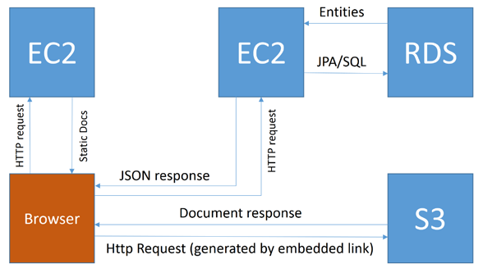
Architectural Elements
ARCHITECTURE
  Deployed on Amazon web services
  EC2 machine for deploying static HTML, JavaScript, CSS and any other supporting documents
  Separate EC2 machine to supply all JSON data to the browser
  RDS will be used to store user data, access control lists, assessment document meta-data, SLOs and SLO groups
  S3 will be used to store assessment documentation

Slide 9
TECHNOLOGIES
The application is JEE compliant using JPA as the persistence layer.
The application will be developed using Spring security and control
AngularJS will manage the client-side application
Bootstrap will be used as the layout and styling engine
Tiles will be used to manage components/templates
HTML documents are written in HTML5

Slide 10
Schedule
Sprint1<year>
Sprint2<year>
Sprint3<year>
Sprint4<year>
Sprint5<year>

